Slide 1
Telecom Churn
Insights Through Predictive Modeling
Henry Lee

Slide 2
Insights Through
Each Data Science Step
PREDICTIVE MODELING
4
3
2
INFERENTIAL
STATISTICS
EXPLORATORY
DATA
ANALYSIS
1
DATA
WRANGLING

Slide 3
1
INSPECT Columns
Missing Data, Imputation, etc.
-------------
2
INSPECT Duplicates
Remove any duplicates
DATA WRANGLING
-------------
3
Union Data
Further complete each dataset
-------------
Renaming
Rename to clarify understanding of dataset
4
-------------
5
Converting / Reindexing
Manipulate dataset to prepare for analysis
-------------

Slide 4
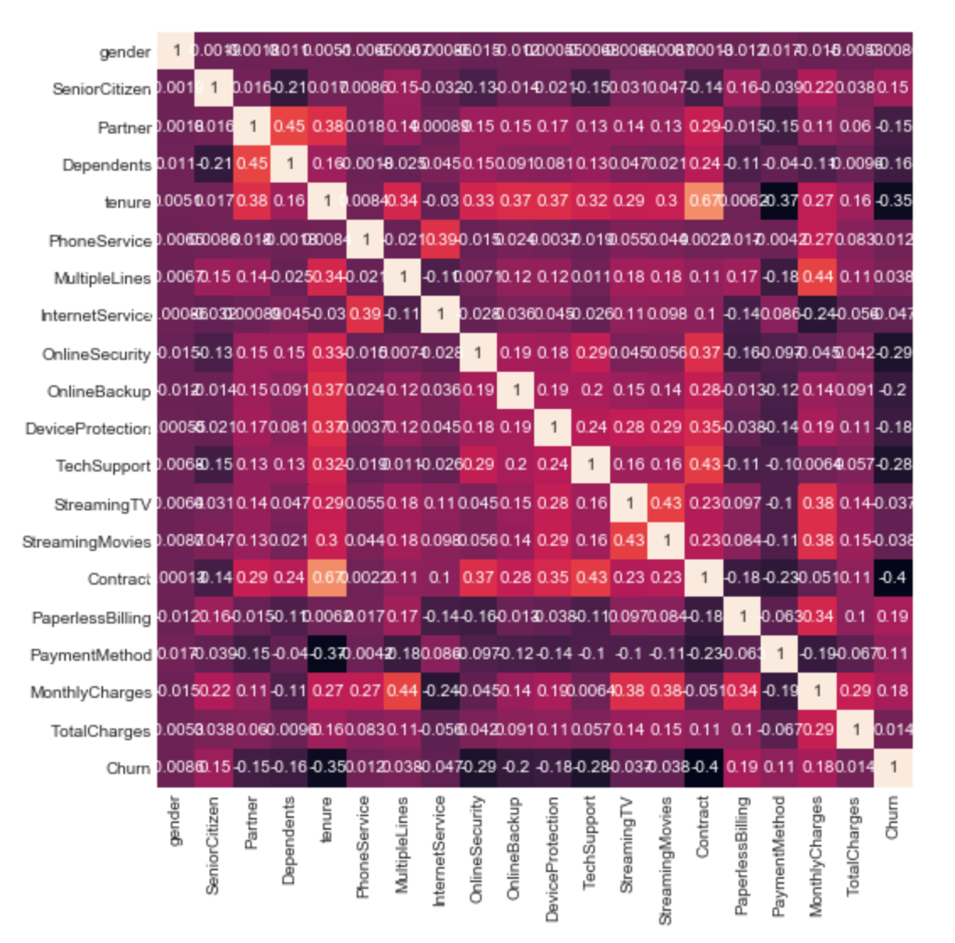
Exploratory Data Analysis
1
Insight 1
Tenure has a relatively higher correlation w/ Contract
Loyalty to the company plays a significant role in the more premium contracts. Thus, focusing more on retaining customers, which gains trust, may lead to upgraded contracts

Slide 5
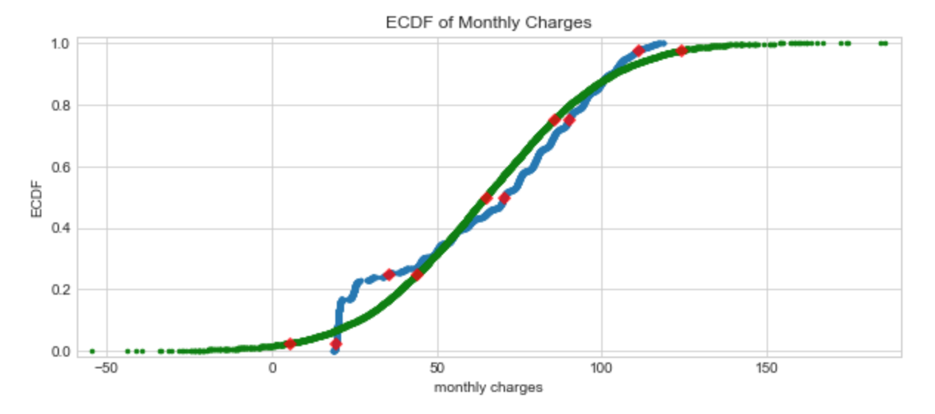
Exploratory Data Analysis
2
Insight 2
Significant discrepancy w/ the normal ECDF plot at .22
22% of customers had monthly charges of $25 or less. The influx here compared to the normal ECDF may indicate action towards focusing more on customers who are just starting out or simply aren’t spending much on services

Slide 6
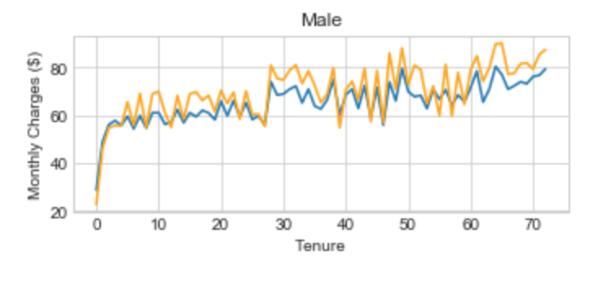
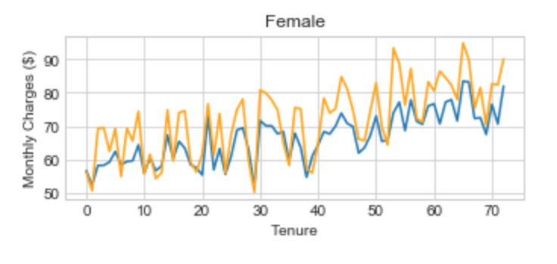
Exploratory Data Analysis
3
Insight 3
There’s a larger variability for females through each year. Tenure 30+, females at more of an upward trend relative to male.
This may be noted when influencing genders that females may tend to be more volatile in spending as they continue to use the service

Slide 7
Inferential Statistics pt 1
Tested if the proportion of churn is equal for each gender
two sample z-test on the difference between our sample proportions
99% confidence interval -0.016 and 0.013
Actions:
Zero is between our 99% confidence interval and thus, gender would not be a significant variable to focus on

Slide 8
Inferential Statistics pt 2
Tested if the proportion of churn is equal for customers on a monthly contract and customers on a one-year plue contract
two sample z-test on the difference between our sample proportions
99% confidence interval .191 and 0.219
Actions:
Focusing on converting customers who are currently on monthly contracts may be worth implementing and maybe perform A/B testing on

Slide 9
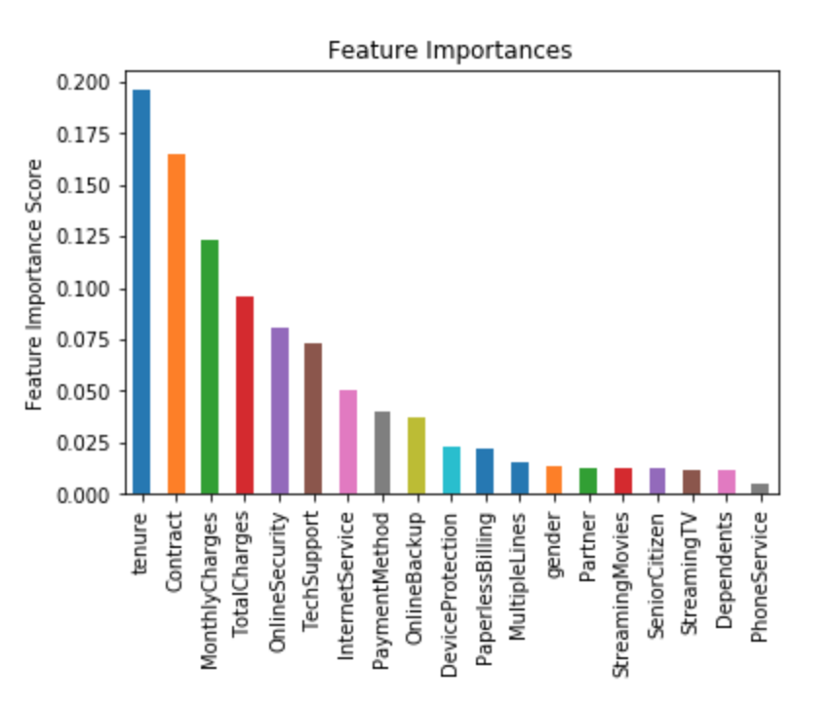
Predictive Modeling
Predict when customers are likely to churn
Random Forest
Gradient Boosting
Support Vector Machine
Accuracy Score: 87.4%
CV Score: 84.4%
Accuracy Score: 81.9%
CV Score: 84.9%
Accuracy: 80.1%
CV Score: 83.8%
Random Forest Classifier
The Random Forest is an ensemble method of the decision tree. The goal of a decision tree is to determine branches that reduce the residual sums of squares the most, and provide the most predictive leaves as possible -- growing branches that reduce classification error.

Slide 10
Final Thoughts
Monthly & Total Charges, Tenure, and Contract Types
Customers who are paying a lot may want to switch to another company for their services. With that said, there may be promotional offers and discounts that may help with luring and convincing customers to avoid churning.
Furthermore, customers who have been loyal for quite sometime may not need to be a significant focus for this Telecom company. The energy and effort may be best optimized on those who have just started using the services provided. This was supported by our EDA as well. Give more reasons for them to stay and once they are hooked, you have maximized your potential.
Lastly, Contract types is a good part to focus since Monthly contract types are there for those who want to be mobile when it comes to telecom service and thus, promotions and maybe deals that force them to lead to a yearly contract may be something to implement as well.

